Slide 1
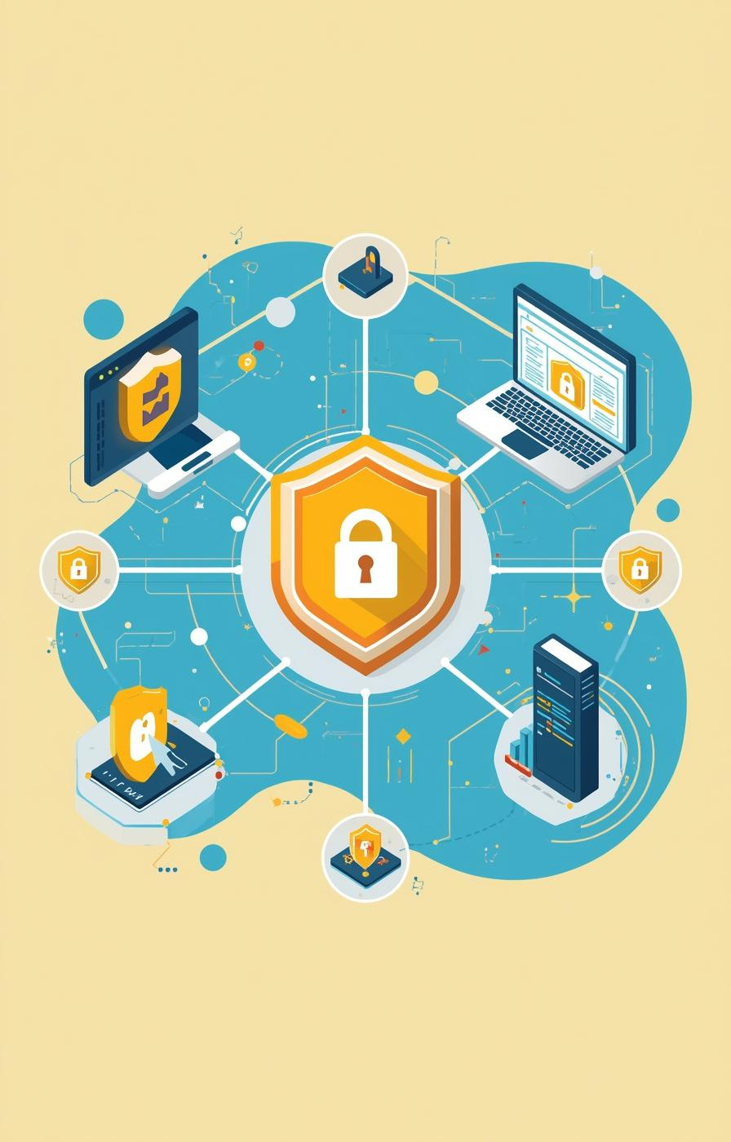

Phishing: Spot and Stop
Protecting yourself from deceptive online attacks and social engineering.
Presented by [Bernard Amoako Agyemang]

Slide 2

What is Phishing?
Phishing is a deceptive cyberattack where malicious actors impersonate legitimate entities via email, text, or malicious websites to steal sensitive data like passwords, credit card numbers, or login credentials.
4

Slide 3
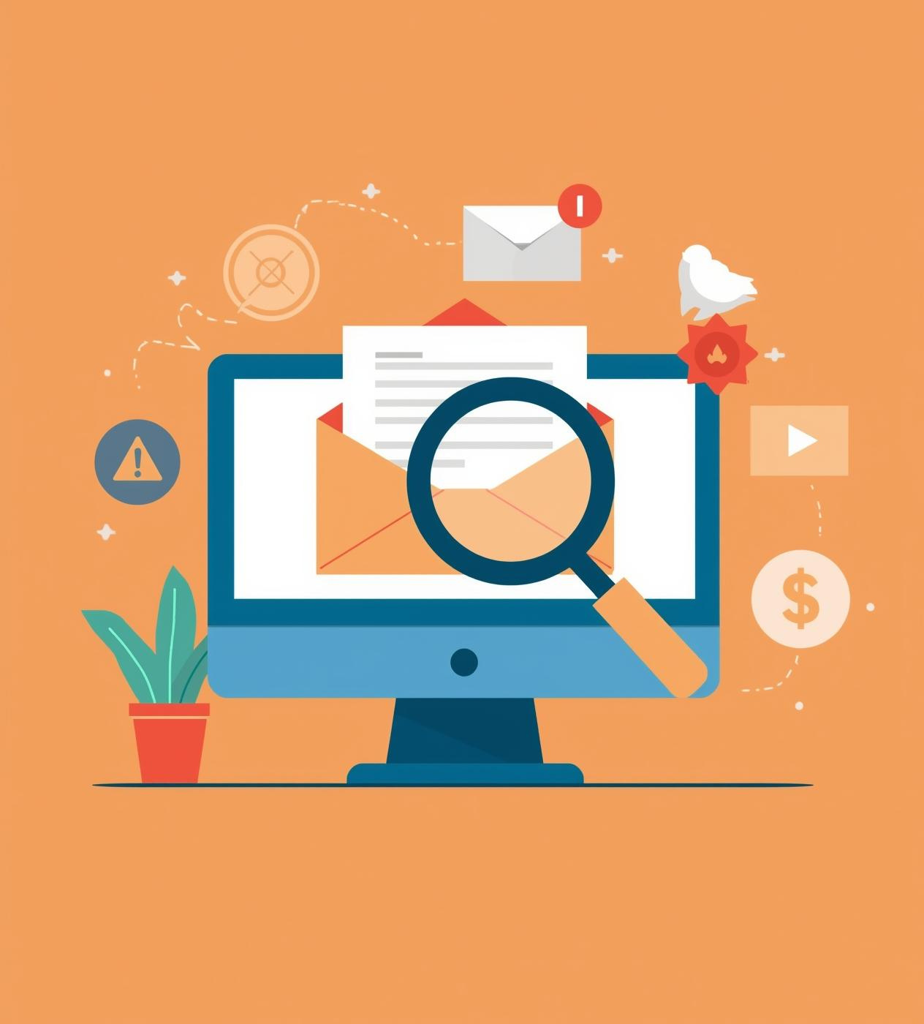
Recognizing Suspicious Senders
Phishing emails often appear legitimate but can hide malicious intent. Look for inconsistencies in sender addresses, unusual requests, and poor grammar as key indicators of potential fraud or deception.

Slide 4

Identifying Counterfeit Websites
Recognizing fake websites is crucial for protecting sensitive information. Look for inconsistencies in URLs, missing security certificates, and mismatched logos to avoid falling victim to scams.

Slide 5
Red Flags
Warning Signs of a Phishing Attack
Suspicious Attachments
Unusual Requests
Grammar Errors
Phishing emails often create a sense of urgency or require personal information. Always verify requests for sensitive data through official communication channels before responding.
Many phishing attempts include poor grammar and spelling mistakes. Legitimate organizations typically maintain professional communication, so be wary of messages that lack attention to detail.
Be cautious of unexpected email attachments, especially from unknown senders. They may contain malware designed to compromise your device and steal sensitive information.
4

Slide 6
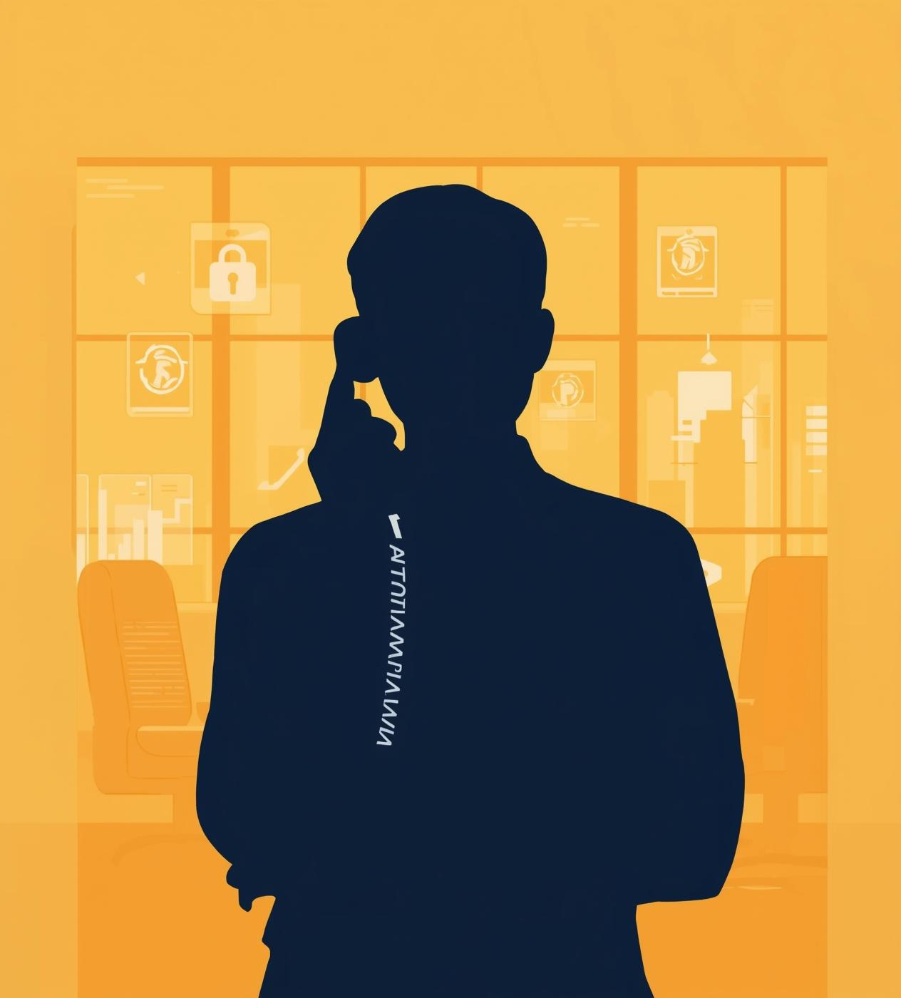
Understanding Social Engineering Tactics
Social engineering exploits human psychology to manipulate individuals into divulging confidential information. Recognizing these tactics—such as urgency, authority, and impersonation—is crucial for safeguarding personal and organizational data.

Slide 7
Best Practices
Tips to Avoid Phishing Attacks
Verify Sender
Check Links
Report Suspicious Emails
Always check the sender's email address carefully. Look for unusual domain names or spelling errors that may indicate a fraudulent source. Confirm with the sender directly if unsure.
Hover over hyperlinks to see the actual destination before clicking. Ensure the URL matches the legitimate website, and avoid entering personal information on suspicious sites.
If you receive a suspicious email, report it to your IT department immediately. Prompt reporting helps protect others and allows for further investigation into potential threats.
6

Slide 8
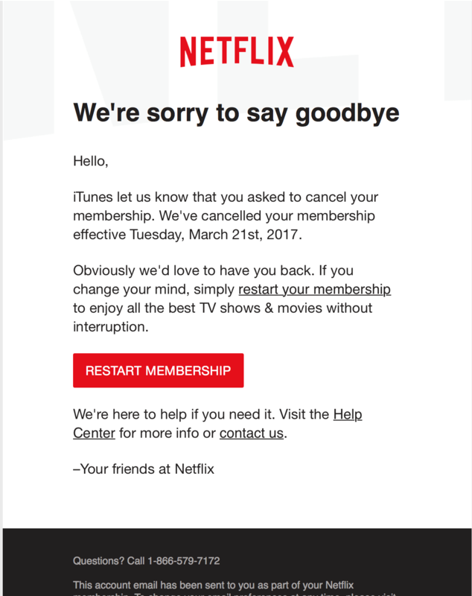
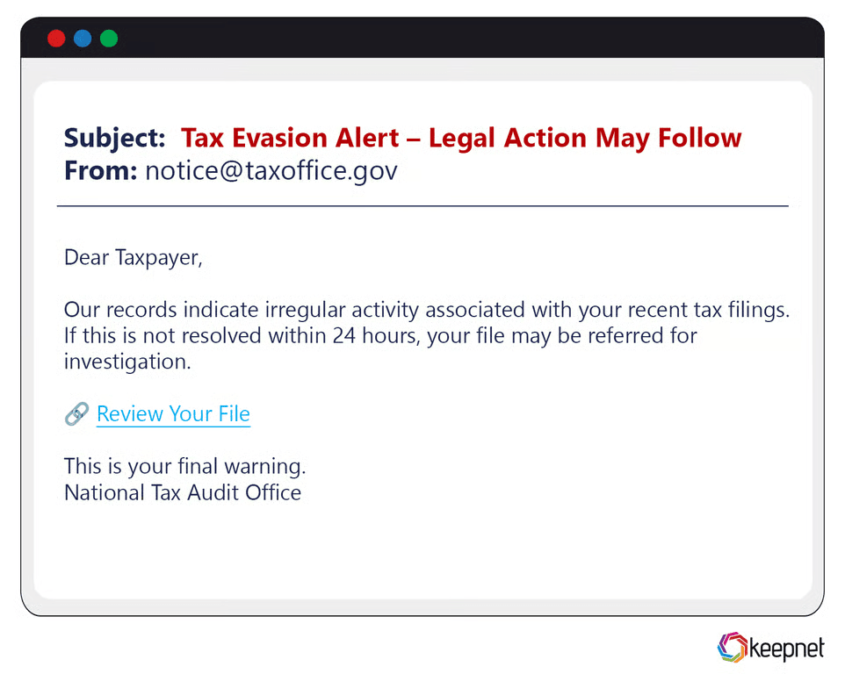
Real-World Phishing Examples
Understanding common phishing tactics

Slide 9
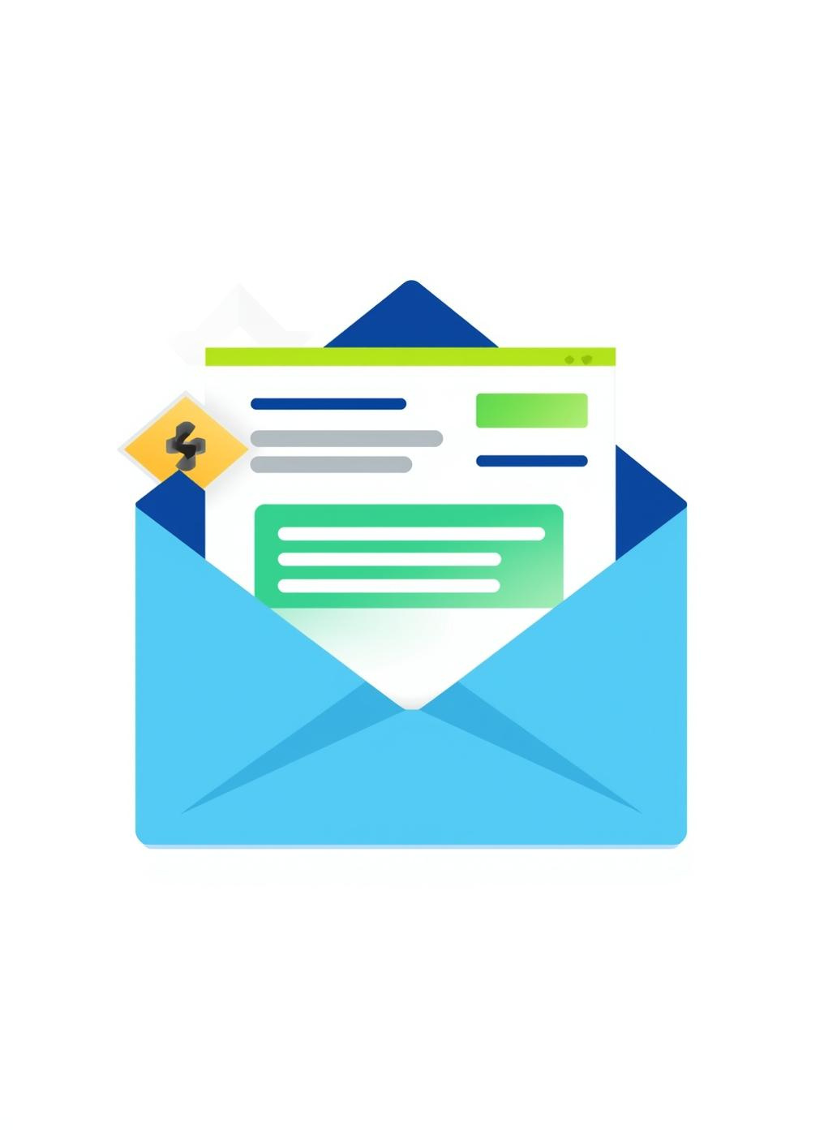
Is phishing Illegal?
Yes
No
Maybe
Unknown

Slide 10
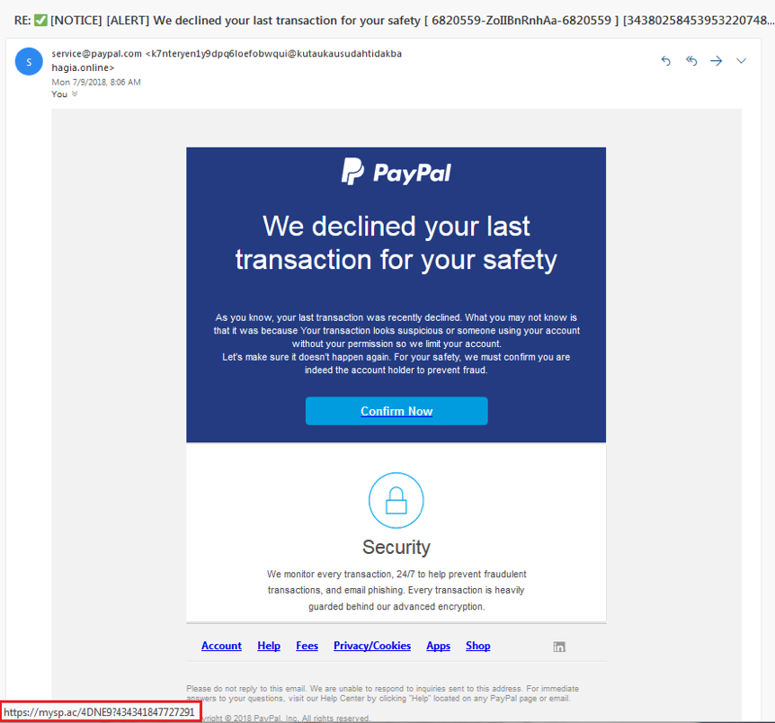
Is this email legitimate or a scam?
Yes, it's legitimate
No, it's a scam
Unsure, ask IT
Need to investigate

Slide 11
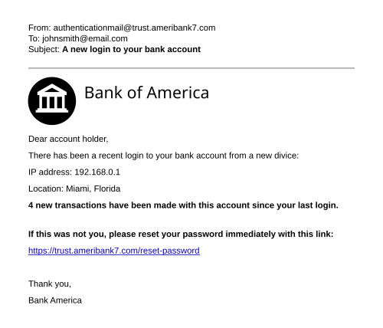
What is the phishing red flag here?
Friendly tone
Proper Grammar
Urgency and fake link
Unknown

Slide 12

Thank You
Stay vigilant, stay safe, and protect yourself online.

